Slide 1
Lecture 17
Multiway Trees

Slide 2
Outline
Multiway Trees
Disjoint-set

Slide 3
Multiway Trees: Definitions
A (free) tree is any set of points (called vertices) and any set of pairs of distinct vertices (called edges or branches) such that (1) there is a sequence of edges (a path) from any vertex to any other, and (2) there are no circuits, that is, no paths starting from a vertex and returning to the same vertex.
A rooted tree is a tree in which one vertex, called the root, is distinguished.
An ordered tree is a rooted tree in which the children of each vertex are assigned an order.
A forest is a set of trees. We usually assume that all trees in a forest are rooted.
An orchard (also called an ordered forest) is an ordered set of ordered trees.

Slide 4
Tree Representations
Parent Method（双亲表示法）
index | data | parent
0 | A | -1
1 | B | 0
2 | C | 0
3 | D | 0
4 | E | 1
5 | F | 1
6 | G | 3
7 | H | 6
8 | I | 6
A
B
C
D
E
F
G
H
I
Easy to get a node’s parent, but difficult to get its children

Slide 5
Tree Representations
/* 树的双亲表示法结点结构定义 */
#define MAX_TREE_SIZE 100
typedef char TElemType; /* 树结点的数据类型 */
struct PTNode /* 结点结构 */
{
TElemType data; /* 结点数据 */
int parent; /* 双亲位置 */
};
Struct PTree /* 树结构 */
{
PTNode nodes[MAX_TREE_SIZE]; /* 结点数组 */
int r, n; /* 根节点的位置和结点数 */
};

Slide 6
Tree Representations
Multiple links（多重链表表示法）
  Representation: The pointer field contains d pointers, where d is the maximum degree of every nodes.
data | child 1 | child 2 | child 3 | …… | child d
A
A
B
C
D
B
^
C
^
^
^
D
^
^
E
^
^
^
F
^
^
^
G
^
E
F
G
H
^
^
^
I
^
^
^
H
I

Slide 7
Tree Representations
Multiple links
  Alternative representation: A number d indicates the degree of the node. And the pointer field contains d pointers.
data | d | child 1 | child 2 | child 3 | …… | child d
A
A
3
B
C
D
B
2
C
0
D
1
E
0
F
0
G
2
E
F
G
H
0
I
0
H
I

Slide 8
Tree Representations
Child-link（孩子链表表示法）
child
next
data
firstchild
A
0
A
1
2
3
^
B
C
D
1
B
4
5
^
2
C
^
3
D
6
^
E
F
G
4
E
^
5
F
^
H
I
6
G
7
8
^
7
H
^
8
I
^

Slide 9
Tree Representations
#define MAX_TREE_SIZE 100
typedef char TElemType; /* 树结点的数据类型 */
typedef struct CTNode /* 孩子结点结构 */
{
int child;
CTNode *next;
} *ChildPtr;
struct CTBox /* 表头结构 */
{
TElemType data;
ChildPtr firstchild;
};
struct CTree /* 树结构 */
{
CTBox nodes[MAX_TREE_SIZE]; /* 结点数组 */
int r, n; /* 根节点的位置和结点数 */
};

Slide 10
Tree Representations
First child next sibling（孩子兄弟表示法）
/* Node declarations for trees */
struct TreeNode
{
TElemType data;
TreeNode *firstChild;
TreeNode *nextSibling;
};
A
B
E
C
A
A
F
D
B
C
D
B
C
D
G
E
F
G
E
F
G
H
H
I
H
I
I

Slide 11
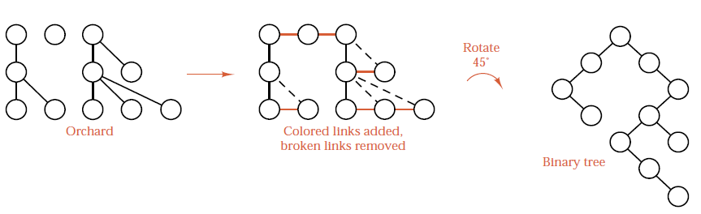
First-child-next-sibling Representation of Orchard
Draw the orchard so that the first child of each vertex is immediately below the vertex.
Draw a vertical link from each vertex to its first child, and draw a horizontal link from each vertex to its next sibling.
Remove the remaining original links.
Rotate the diagram 45 degrees clockwise, so that the vertical links appear as left links and the horizontal links as right links.

Slide 12
First-child-next-sibling Representation of Orchard
B
C
D
B
C
D
E
F
G
E
F
G
H
I
H
I
B
E
C
F
D
B
C
D
G
E
F
G
H
H
I
I

Slide 13
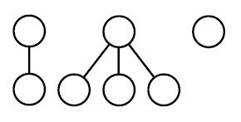
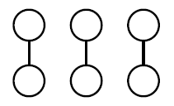
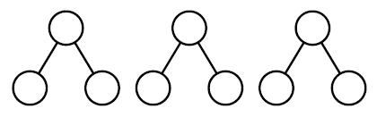
Exercise
Convert each of the following orchards into a binary tree.

Slide 14
Forest Traverse
Preorder traverse: First root then children
Preorder: BEFCDGHI Preorder: BEFCDGHI
Preorder traversal of the orchard is equivalent to the preorder traversal of the corresponding binary tree
B
E
C
B
C
D
F
D
E
F
G
G
H
I
H
I

Slide 15
Forest Traverse
Postorder traverse: First children then root
Postorder: EFBCHIGD Inorder: EFBCHIGD
Postorder traversal of the orchard is equivalent to the inorder traversal of the corresponding binary tree
B
E
C
B
C
D
F
D
E
F
G
G
H
I
H
I

Slide 16
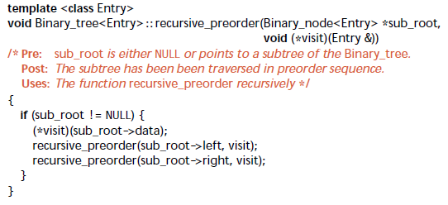
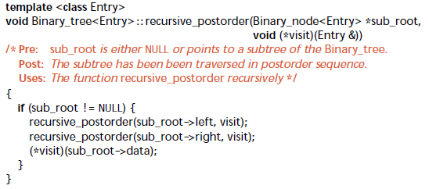
How to modify tree traversal into forest traversal?

Slide 17
Disjoint-set(并查集) Forests
Disjoint-set forests are data structures where each set is represented by a tree data structure, in which each node holds a reference to its parent node
In a disjoint-set forest, the representative of each set is the root of that set's tree. Find follows parent nodes until it reaches the root. Union combines two trees into one by attaching the root of one to the root of the other.
Example: S1 = {0, 6, 7, 8}, S2 = {1, 4, 9}, S3 = {2, 3, 5}
0
1
2
6
7
8
4
9
3
5

Slide 18
Disjoint-set Forests
Use Parent method to represent disjoint-set forests.
Two operations considered here
  Disjoint set union
  S₁ ∪ S₂ = {0,6,7,8,1,4,9}
  Find(i): Find the set containing the element I,
  3 ∈ S₃, 8 ∈ S₁
0
1
2
6
7
8
4
9
3
5

Slide 19
Disjoint-set: Union
Idea: Make one of trees a subtree of the other
The rule for merging two sets A and B is that if A is larger than B then merge the elements of B into A and update the elements that used to belong to B, and vice versa.
In this case, Find(i) takes O(log n) time.
0
1
8
1
0
4
9
6
7
4
9
6
7
8
Possible representation for S1 union S2

Slide 20
Disjoint-set Operations: Union
Eight elements, initially in different sets
After Union(4,5)
0
1
2
3
4
5
6
7
-1 | -1 | -1 | -1 | -1 | -1 | -1 | -1
0 | 1 | 2 | 3 | 4 | 5 | 6 | 7
0
1
2
3
4
6
7
5
-1 | -1 | -1 | -1 | -1 | 4 | -1 | -1
0 | 1 | 2 | 3 | 4 | 5 | 6 | 7

Slide 21
Disjoint-set Operations: Union
After Union(6,7)
After Union(4,6)
0
1
2
3
4
6
5
7
-1 | -1 | -1 | -1 | -1 | 4 | -1 | 6
0 | 1 | 2 | 3 | 4 | 5 | 6 | 7
0
1
2
3
4
5
6
-1 | -1 | -1 | -1 | -1 | 4 | 4 | 6
0 | 1 | 2 | 3 | 4 | 5 | 6 | 7
7

Slide 22
Disjoint-set Operations: Quick-Find
Current
After Find(7)
0
1
2
3
4
5
6
-1 | -1 | -1 | -1 | -1 | 4 | 4 | 6
0 | 1 | 2 | 3 | 4 | 5 | 6 | 7
7
0
1
2
3
4
5
6
7
-1 | -1 | -1 | -1 | -1 | 4 | 4 | 4
0 | 1 | 2 | 3 | 4 | 5 | 6 | 7

Slide 23
Union by Rank & Path Compression
Union by Rank: Each node is associated with a rank, which is the upper bound on the height of the node (i.e., the height of subtree rooted at the node), then when UNION, let the root with smaller rank point to the root with larger rank.
Path Compression: used in FIND-SET(x) operation, make each node in the path from x to the root directly point to the root. Thus reduce the tree height.
f
f
e
c
d
e
d
c

Slide 24
Disjoint-set Implementation
int p[maxn];
int find(int x) {
return (p[x] == -1) ? x : p[x] = find(p[x]);
}
int union(int x, int y) {
p[find(y)] = find(x);
}
int main() {
for (int i = 0; i < n; i++)
p[i] = -1;
…
union(x, y);
if (find(x) == find(y)) …
}

Slide 25
Time Complexity
MAKE-SETs requires O(V).
FIND-SETs and UNIONs perform O(E) time. Assuming the implementation of disjoint-set data structure that uses union by rank and path compression, so amortized in O(E α(V)). (α为反ackerman函数)
O(E α(V)) is almost linear.

Slide 26

Thank you!

